Slide 1
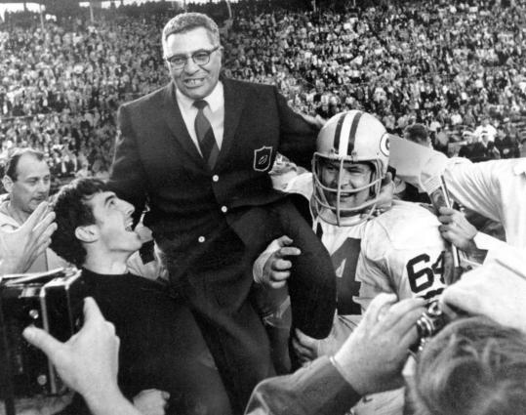
Success in the NFL
Winning isn’t everything, it’s the only thing”.
-Vince Lombardi
By: Robert Hoehn-Saric &
Corey Barber-Bockelman

Slide 2
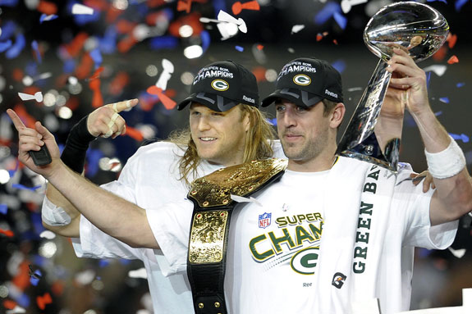
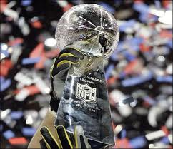
Road to Success
The experiment was to examine the many different facets that make a team great. Great being defined as the ultimate success, winning the super bowl.
To find success, the experiment took overall league data ranging back to the NFL merger, as well as compared the statistics of various super bowl winning teams.
Through various graphs plotting different aspects on the offensive and defensive sides of the ball, the experiment sought out to answer a few questions.
“Does defense win championships?”-Do you need a top caliber defense to win.
“Ground and pound or air it out?” Is it more important to be a strong rushing team or passing team. Has there been a shift or trend?
“Will the Packers repeat?”

Slide 3
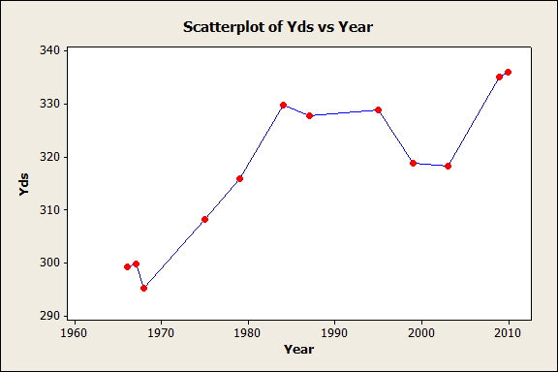
League Stats
It’s important to find out the trends of the League to find out which data is more prevalent depending on the time period.
The average yards per game increased significantly since the 1966 merger.
Reasons to explain why yardage has increased are; New rules benefitting the offenses, that evolution of the West Coast offense and the Pocket Quarterback, more complicated passing schemes, and a heavier reliance on passing the ball.

Slide 4
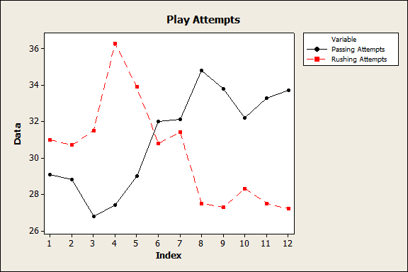
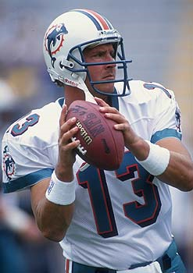
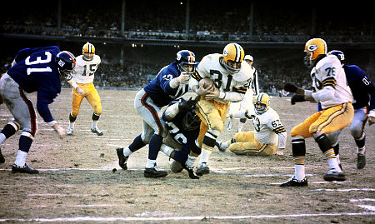
The average passing attempts of the league have increased significantly as the rushing attempts have plummeted. Clarifying the league over time became a pass first league opposed to the original theories of Lombardi and other early run first coaches.

Slide 5
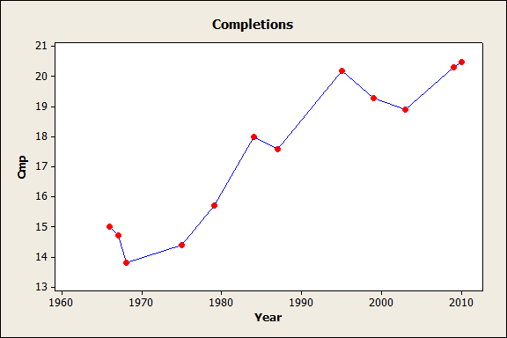
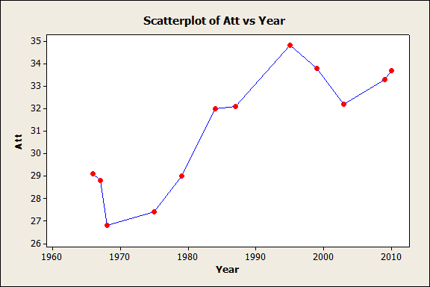
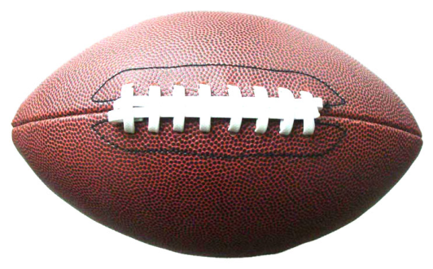
Passing Yardage, completion percentage, average yards per play all increased.
The passing accounts for the league rise in yardage due to the speed and average yardage per play that the modern passing systems have proved.
The role of quarterback greatly expanded too, accounting for more than 50% of the offense. They went from game managers to play callers.

Slide 6
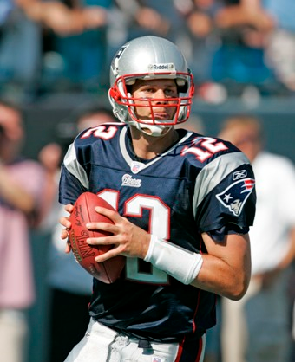
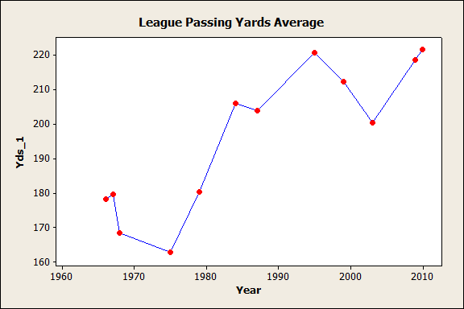
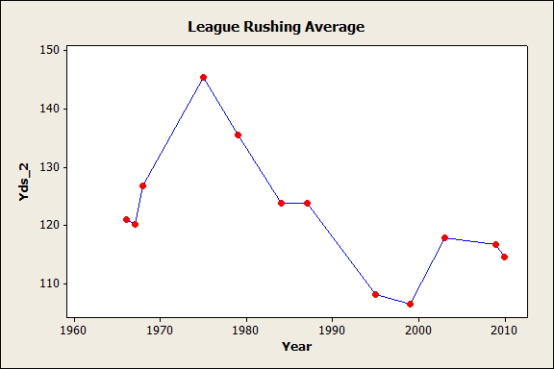
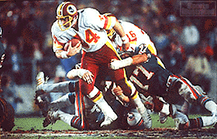

Slide 7
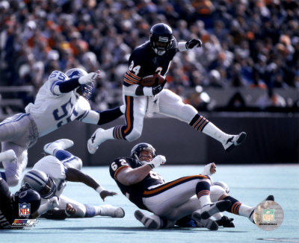
Offensive Super Bowl Trends
Just as the league has become more passing oriented so have the most successful teams.
Now there are very few run orientated offenses who are successful with the Steelers being the biggest exception.
It is clear that the league is following in the footsteps the of the first few successful passing heavy teams such as Joe Montana and the San Francisco 49ers.

Slide 8
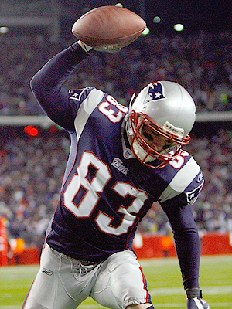
Not the Same Game
Not only has passing become more prevalent but the style of passing has changed.
Quarterbacks now use running backs not only as runners but check down receivers as well.
This West Coast offensive style allows for a higher completion percentage and lets receivers do more running the ball in the open field.

Slide 9
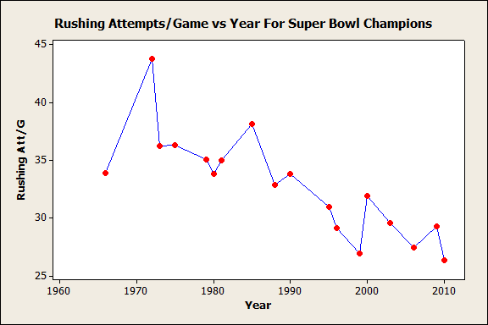
Why So Popular?
A passing oriented offense is very appealing to successful teams for many reasons.
For one passing lets you spread the field and gives the defenders much more ground to cover.
Passing also has much more of a mental side to it while running takes less brains and more brawn.
Finally passing is much more exciting and has a much bigger upside. In a money oriented league fans are much more excited by Tom Brady stepping back, waiting that extra second, and bombing it to Randy Moss than watching Jerome Bettis run into a pile 30-40 times.

Slide 10
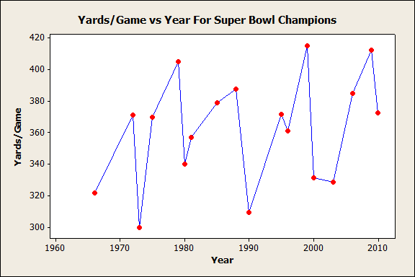
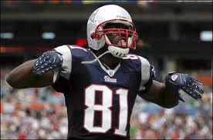
Does It Work?
Although the style of offense has been revolutionized, points per game and yards per game among super bowl champions haven't seen the increase that one would have expected.

Slide 11
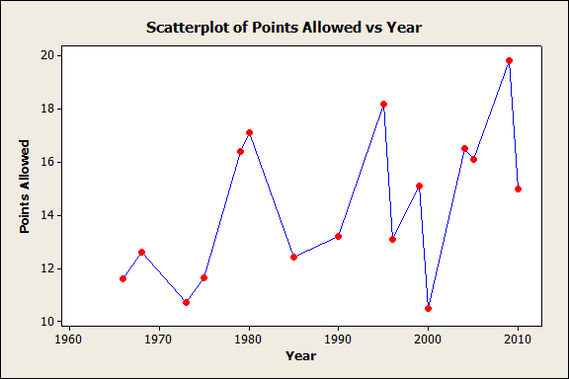
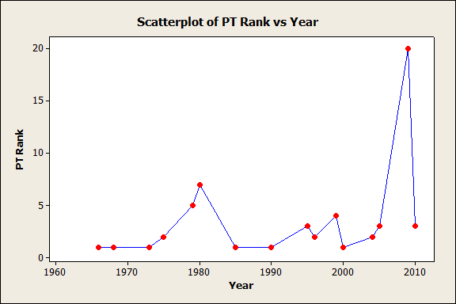
Super Defense
As you can see there is not a dramatic increase in the number of points Super bowl winning teams allowed to score from 1966 to 2010.
The rank of scored points on the SB teams consistently ranks below the top 5, roughly 1/8 of the SB teams don’t rank with the leagues top 5.
Concluding: Super bowl winning teams don’t give up points.

Slide 12
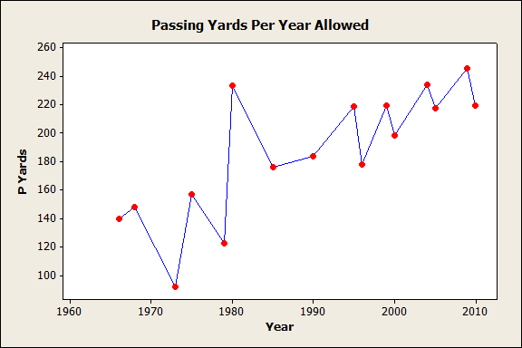
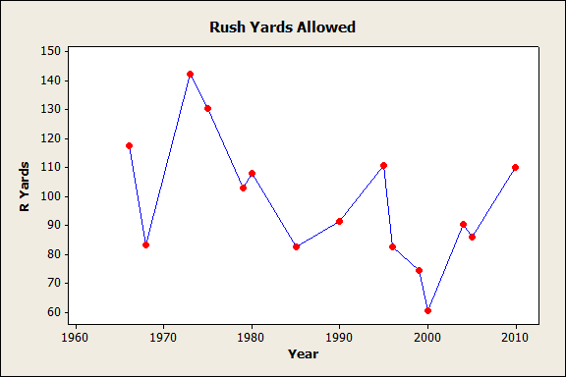
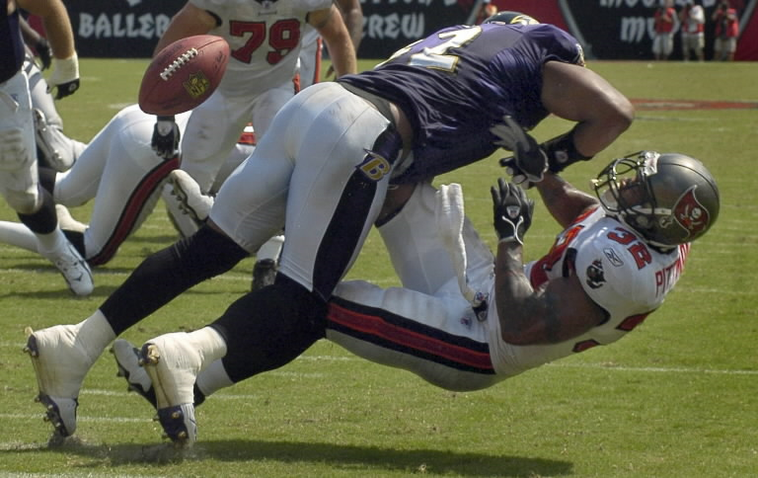
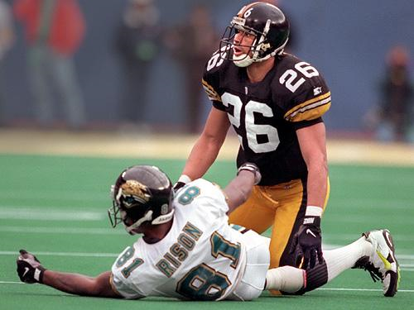
With the evolution of the pass throughout the league there is a correlation to defenses allowing more pass yardage. Due to the increase of pass yardage the rush yards allowed decreased.

Slide 13
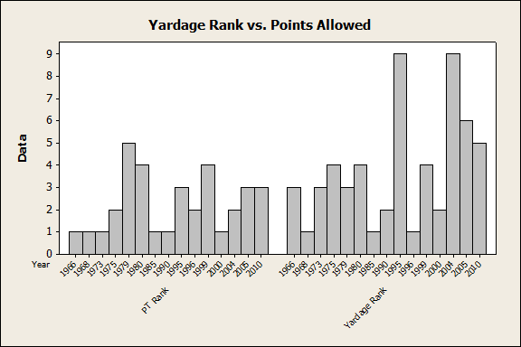
The Rankings show that its more important for the defense to give up less points than less yardage.
Both rankings are top 10 in the league for defenses.
Conclusions: Yardage doesn’t matter as much when the team defends the end zone well. Defense wins championships.

Slide 14
In Conclusion…
“Does defense win championships?”-Clearly, the majority of teams were ranked in the top 5 lowest points and yardage given up. And all of the teams were at least top 10. No team can win or last in the playoffs with a defensive liability.
“Ground and pound or air it out? Has there been a shift or trend”?- The league data shows that the ground and pound era is over, while passing has taken its place. Teams can no longer build themselves around running backs while the stock of quarterbacks is on the rise.
“Will the Packers repeat?”-Yes, they ranked 2nd and 3rd respectively in defensive stats. They also have a top caliber offense led by future hall of famer Aaron Rodgers!

Slide 15
